Slide 1
GCP end to end data pipeline
08/08/22
Kerbs Boris

Slide 2
Agenda
Introduction
Used Techs
Pipeline Diagram
Demo

Slide 3


Introduction
Report?
Streaming?
Batch?
KPI?
Dashboard?
Data Origin
Data Ingestion
Storage
Visualizations
JSON?
SQL?
CSV?
NoSQL?

Slide 4


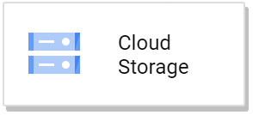
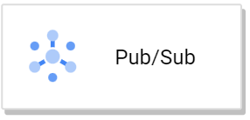

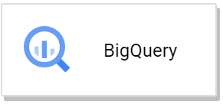
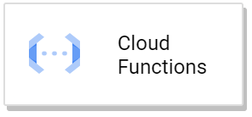
Technologies
Data Origin
Data Ingestion
Store
Visualizations

Slide 5
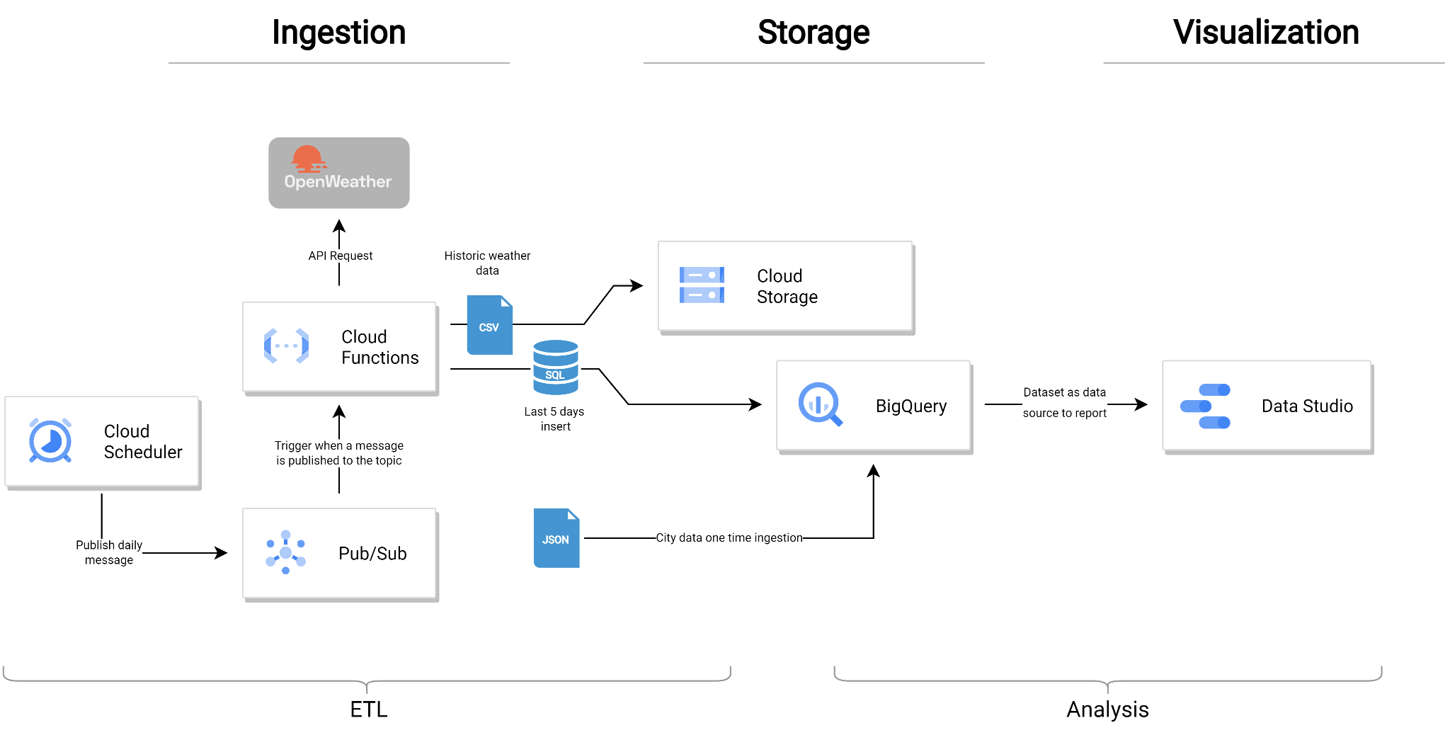
Architecture

Slide 6
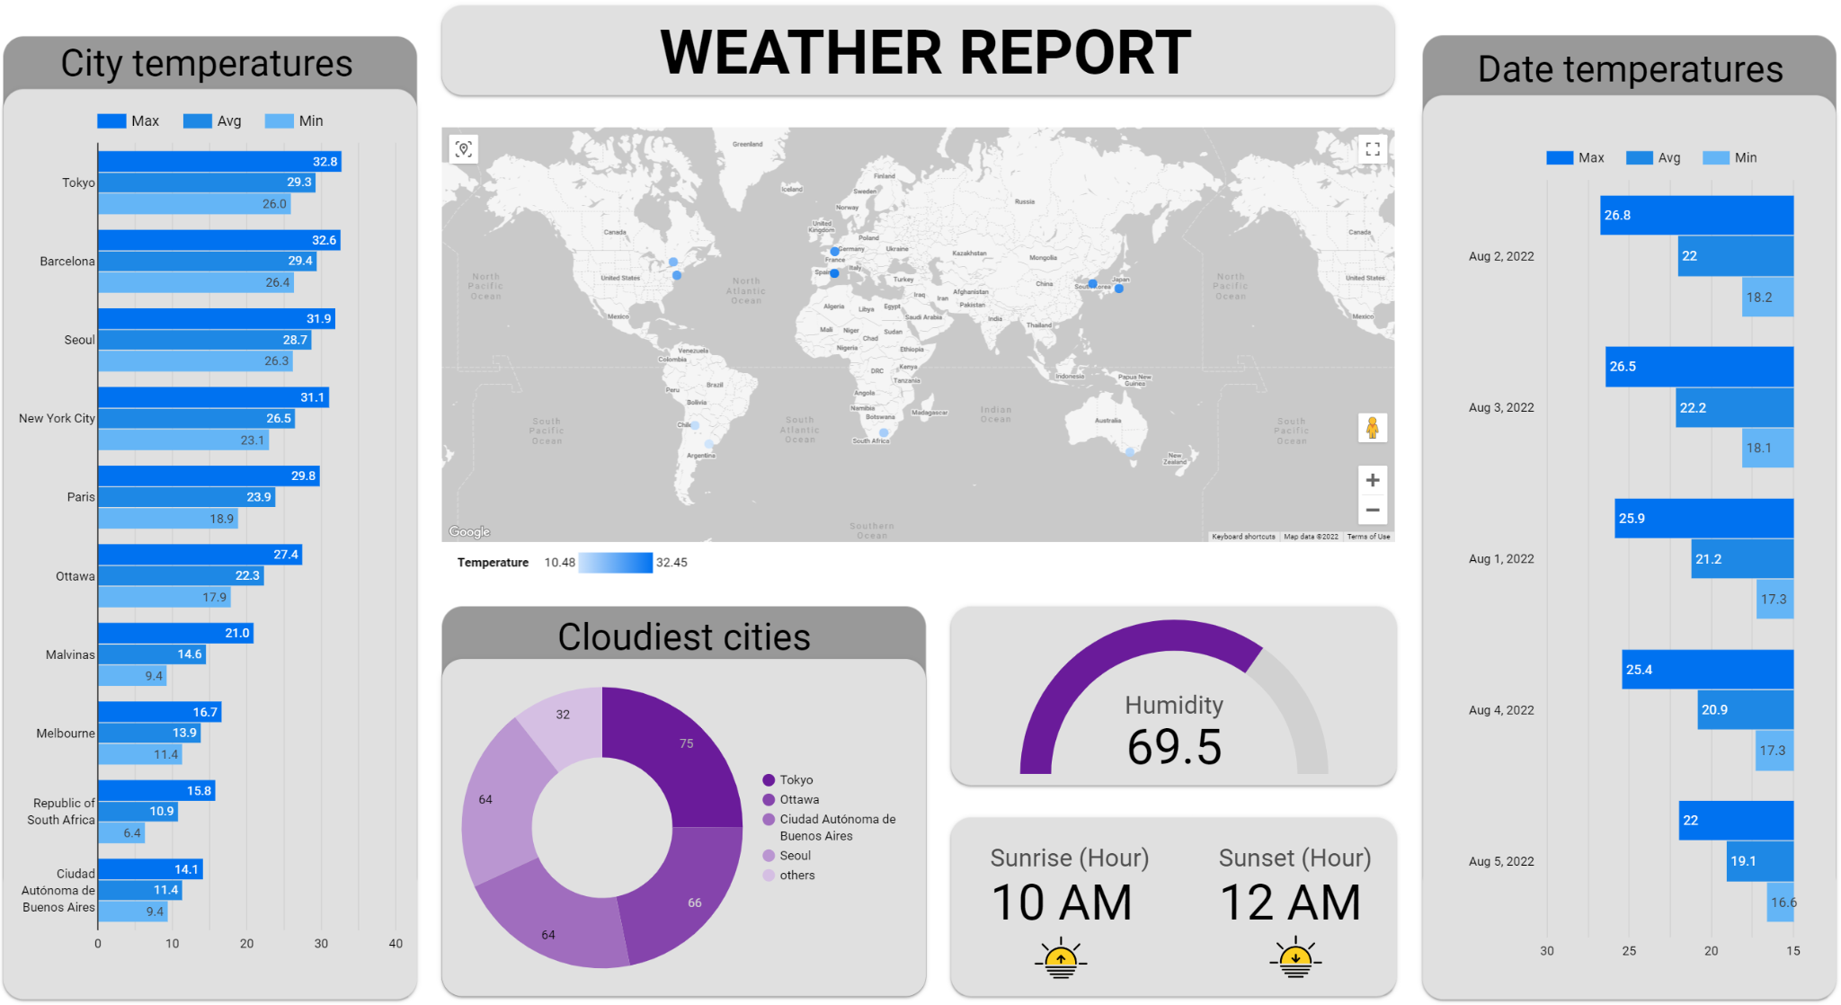
Demo Dashboard

